Slide 1


Code_seminar
Kim Hyun Woo
Network Science Lab
The Catholic University of Korea
E-mail : kimwoohyun0622@gmail.com

Slide 2
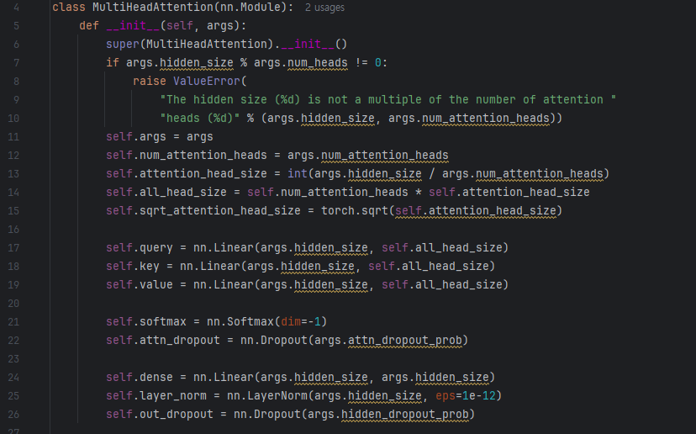

Slide 3

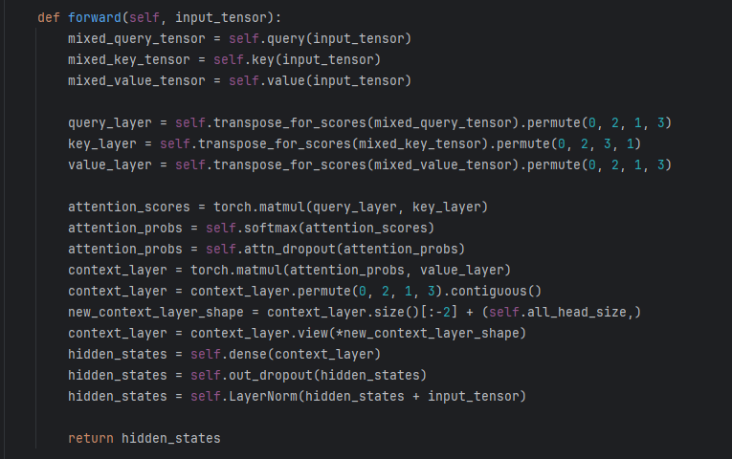

Slide 4
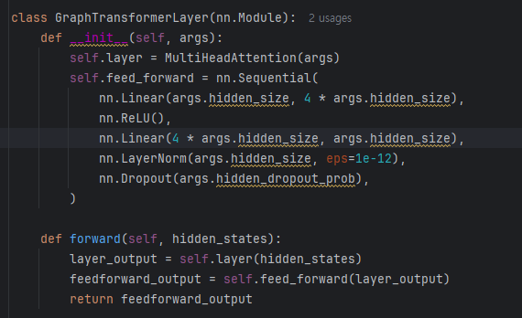

Slide 5
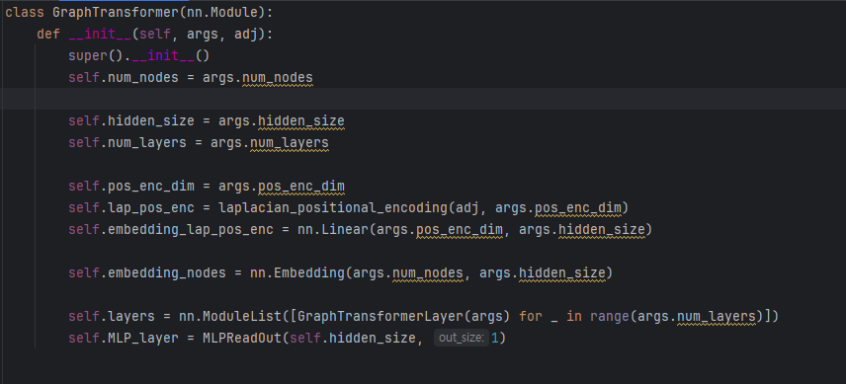
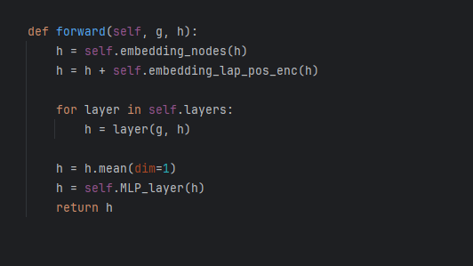

Slide 6
